Slide 1
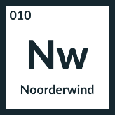

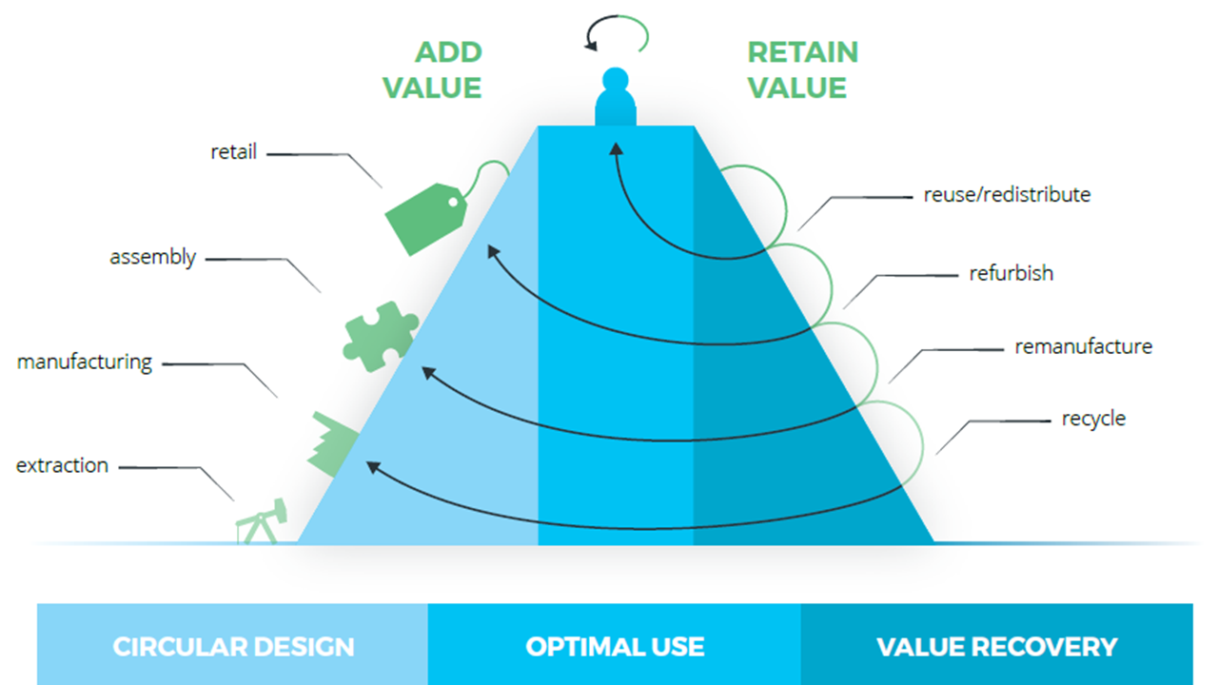
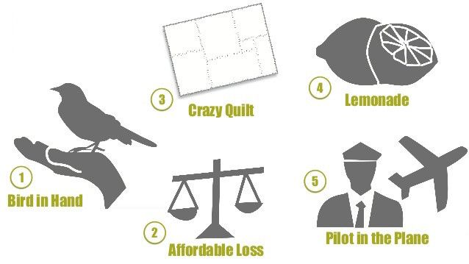
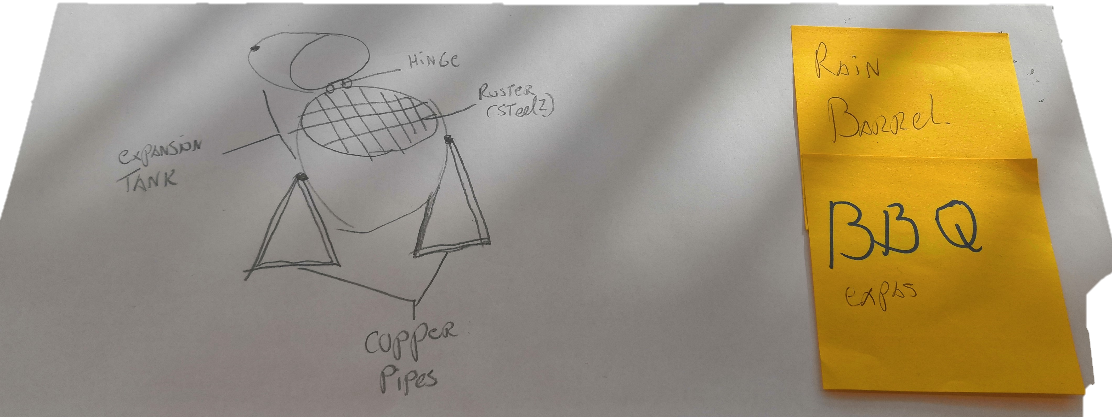



Idea development
Idea description: BBQ, small enough to serve 2-4 persons
Can this idea be realized locally? How? The copper pipes and hinge must be welded together. The expansion tank is already cut in half. We need to add a roster.
Parts and/or materials used: Expansion tank, copper pipes, hinge.
Where is this idea located on the value pyramid? Remanifacture
New function of the idea: Expansion tank: Be the basis for the BBQ. Copper pipes: being used as a standard for the BBQ. Hinge: still as a hinge, but for holding the two halves of the BBQ together.
Are the things, needed to accomplish this, within your reach? At the moment we do not know someone who can weld the pieces together or what material to use for the roster.
Draw idea:
Some of the images used on this workshop come from Circle-e
This work is licensed under the Creative Commons Attribution-Share Alike 3.0 Unported License

Slide 2
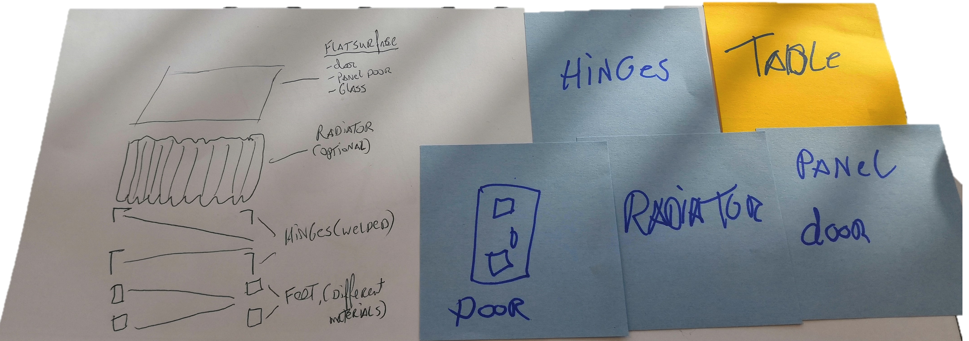
Idea development
Idea description: a ‘Configurable Table’
Can this idea be realized locally? How? For this idea we have to contact someone who can help with creating a configurable production process. So a furniture designer is required.
Parts and/or materials used: Top: (panel) door, glass middle: Radiator (optional) bottom: Hinges of feet made of the doors
Where is this idea located on the value pyramid? Remanifacture.
New function of the idea: A table is always needed in a house, and the flat surface of the materials can still be used, even when they are old.
Are the things, needed to accomplish this, within your reach? No, we need to make a configurable process for creating the table and then we need to find someone to create the table itself.
Draw idea:
Some of the images used on this workshop come from Circle-e
This work is licensed under the Creative Commons Attribution-Share Alike 3.0 Unported License

Slide 3

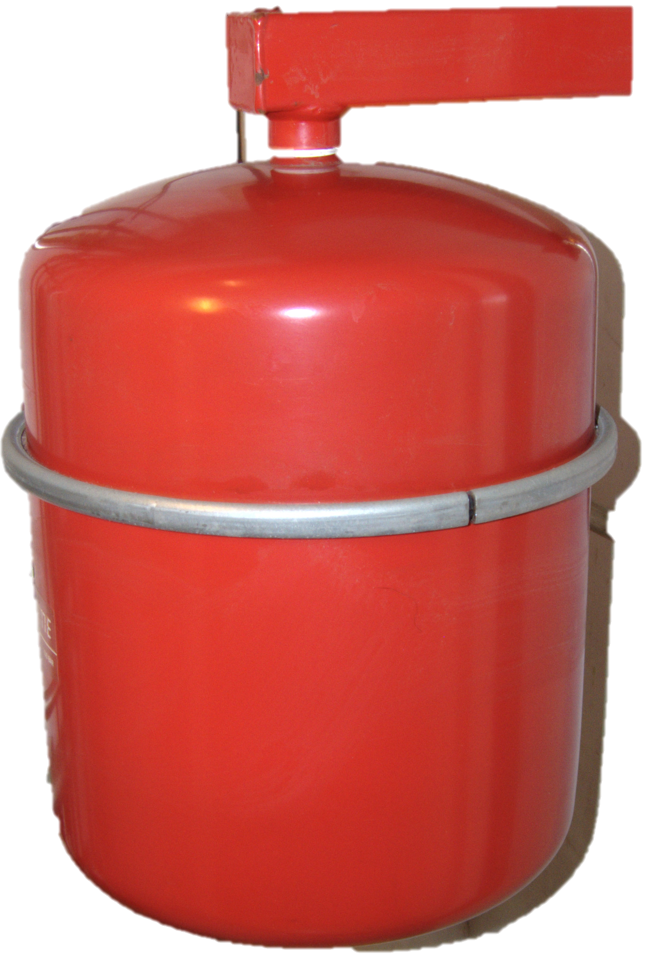

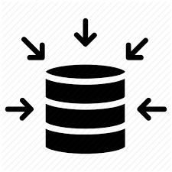
Idea development
Idea description: Rainbarrel
Can this idea be realized locally? How? Noorderwindt gave us a contact of Bas Sala
Parts and/or materials used: Expansion tank
Where is this idea located on the value pyramid? Reuse
New function of the idea: Reusing the expansion tank for what it is intented for: Rainbarrels.
Are the things, needed to accomplish this, within your reach?
No, we need to contact Bas Sala to get a clear picture of the production process and the steps we can take to ready the device.
Draw idea:
Data
Some of the images used on this workshop come from Circle-e
This work is licensed under the Creative Commons Attribution-Share Alike 3.0 Unported License

